Slide 1
Bouncing Ball Game

Slide 2
Last time
String object
Input / Output
Comparison operators
Branching and conditionals
Iteration and loops
Hello world pygame

Slide 3
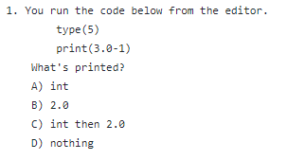
Quiz

Slide 4
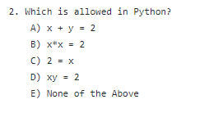
Quiz

Slide 5
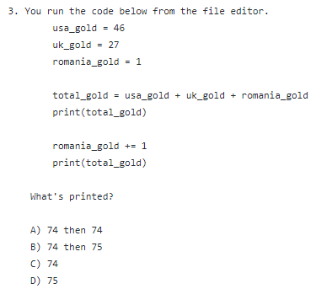
Quiz

Slide 6
Today
Pygame basics
Surface object
Rect object
Colors
Drawing images
Bouncing ball game

Slide 7
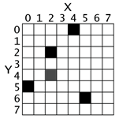
2D Pixel Coordinates
2D pixel coordinates
Black: (4,0), (2,2), (0,5), (5,6)
Gray: (2,4)

Slide 8
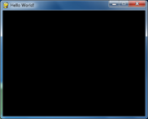
Surface Object
Surface objects represent rectangle 2D images
Display surface: pygame.display.set_mode((width, height))
pygame.display.set_caption(‘Hello World’)

Slide 9
Colors
Three primary colors
Red, Green, Blue (RGB)
Other colors are the combination of different amount of RGB

Slide 10
Colors
Pygame Color objects
Tuples of three integers (0-255) representing (R,G,B)
Color | Tuple
Red | (255, 0, 0)
Green | (0, 255, 0)
Blue | (0, 0, 255)
White | (255, 255, 255)
Black | (0, 0, 0)
Yellow | (255, 255, 0)

Slide 11
Rect Object
Tuple of 4 integers
X coordinate of the top left corner (pixel)
Y coordinate of the top left corner (pixel)
Width of the rectangle (pixel)
Height of the rectangle (pixel)
Create Rect Object
pygame.Rect(10, 20, 200, 300)
x
Surface
width
Rect
y
height

Slide 12
Draw image
Load images to surface objects from PNG, JPG, GIF and BMP files
ball=pygame.image.load(image_file)
Copy to display surface
screen.blit(ball, (ball_x, ball_y))
screen.blit(ball, rect_object)
x
Surface
top-left
ball
y

Slide 13
Animation
Animated images are the result of drawing an image on the screen, then a split second later drawing a slightly different image on the screen.
Move object
ballrect = ballrect.move((speed_x, speed_y))
Erase the screen
screen.fill(black)
Copy the object to screen
screen.blit(ball, ballrect)
Update monitor
pygame.display.update()
Pause
time.sleep(0.01)
Go to the first step
x
Surface
y
ball

Slide 14
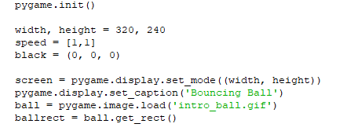
Bouncing Ball Game

Slide 15
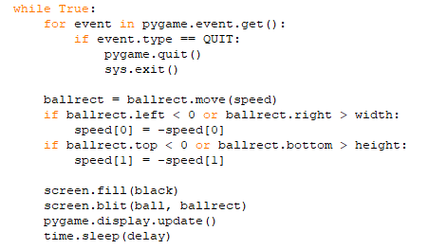
Bouncing Ball Game (2)

Slide 16
https://github.com/zhihongzeng2002/pythongame
Bouncing_ball.py
Intro_ball.gif

